Slide 1
General Overview of Belgian Companies by Sector
Estefania Sosa
July 25, 2025

Slide 2
What it is in this report
01. Introduction
02. The most important sectors
What are the general framing of this work and why it is important
An overview of the top ten economic sectors in Belgium
03. Juridique Matters
04. Time of Commerce
05. Conclusion
What are the legal constitution of the enterprise in Belgium and in which sectors
In which time Belgian companies were established
What is the oldest sector? What sectors are growing?
What have we learned and what do we do now.

Slide 3

Introduction
The Belgian entrepreneurial sector is vast and long-lived. This analysis tries to scratch the surface of the data to reveal a general overview of how these sectors are composed and what are their primary characteristics.
Preliminary analysis of the data yielded around 80+ economic sectors where the Belgians develop their commercial activities. This study will focus on the top 10 sectors according to the NACE2025, which is the latest version of the code.

Slide 4
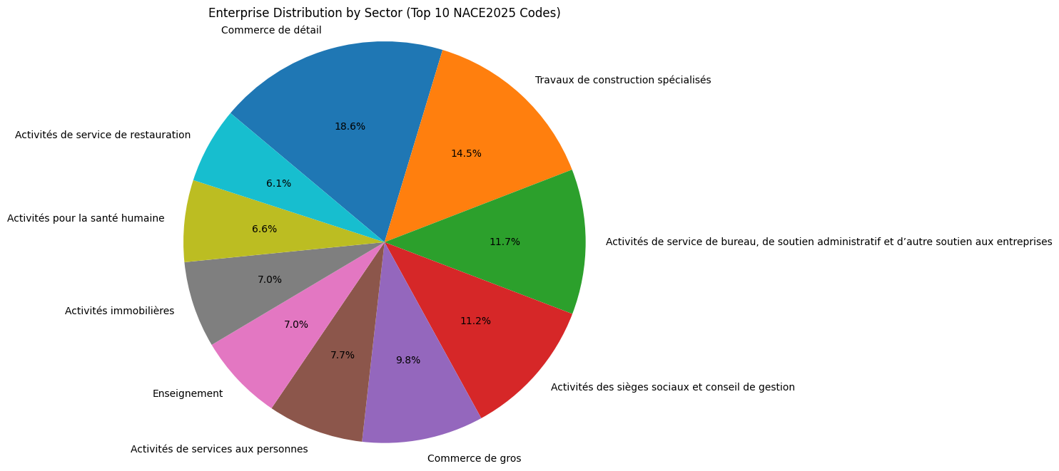
The most important Belgian Economic Sectors
Retail commerce is the most important activity with construction is the second largest. This is a sign of an economy that demands infrastructure, housing and everyday service for its inhabitants
Administrative and consultant services are the next most important sectors. With a country capital focused on bureaucratic labor, this is to be expected.

Slide 5
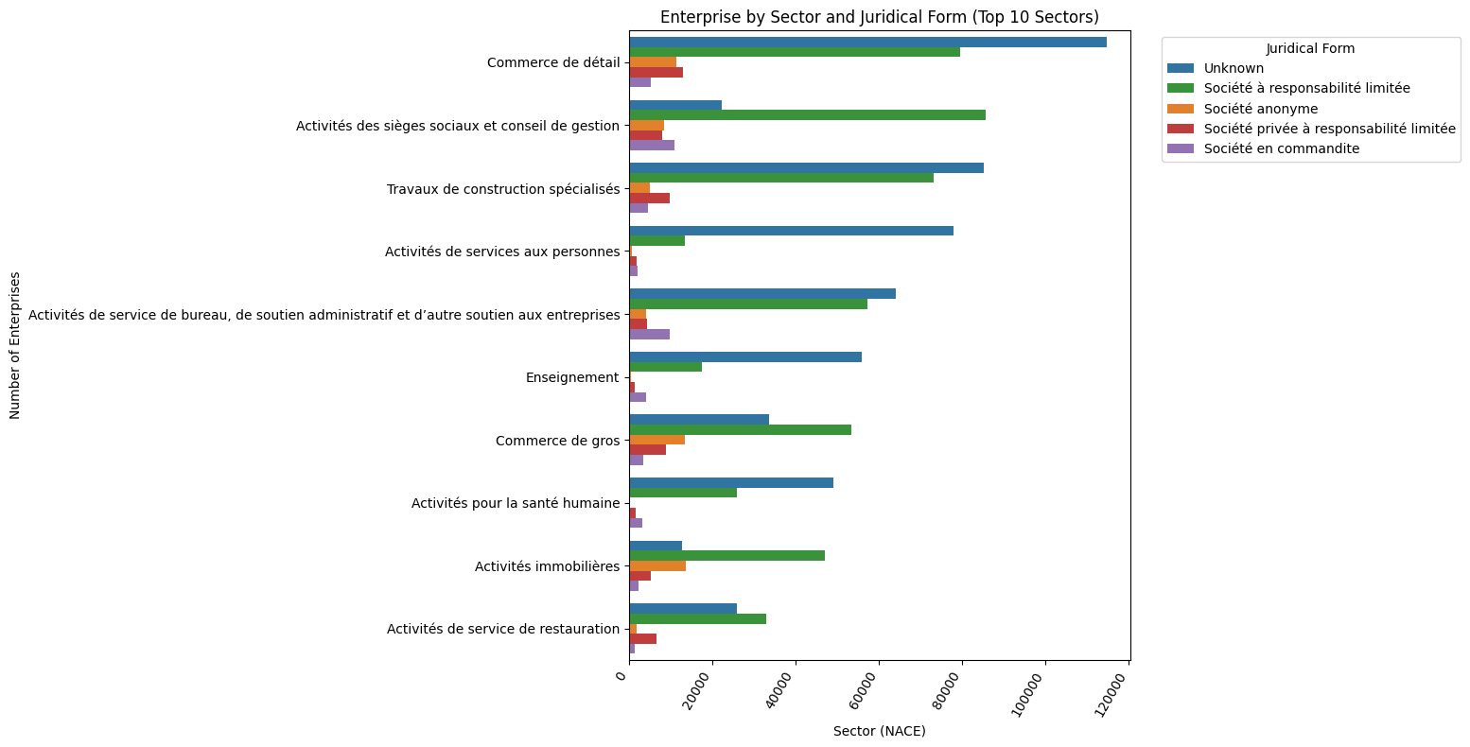
Juridical Form
There is no information about the legal composition for most companies in the top 10 sector. This might be due to the mismatch between IDs (Enterprise vs Establishment) or some enterprises, for example small businesses, do not need to register this aspect
It is probably needed for a consultant company to be registered as a limited liability company. This is the only sector whose most common juridical form is not unknown

Slide 6
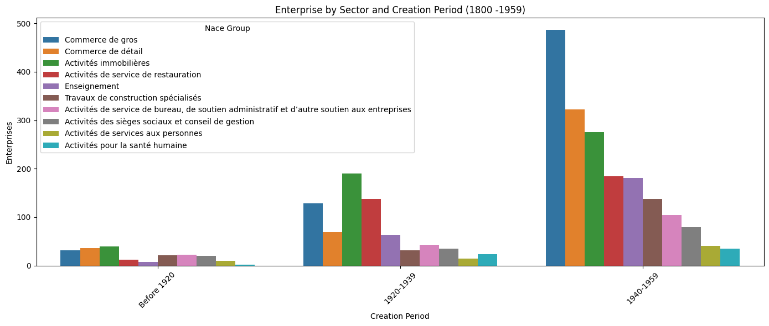
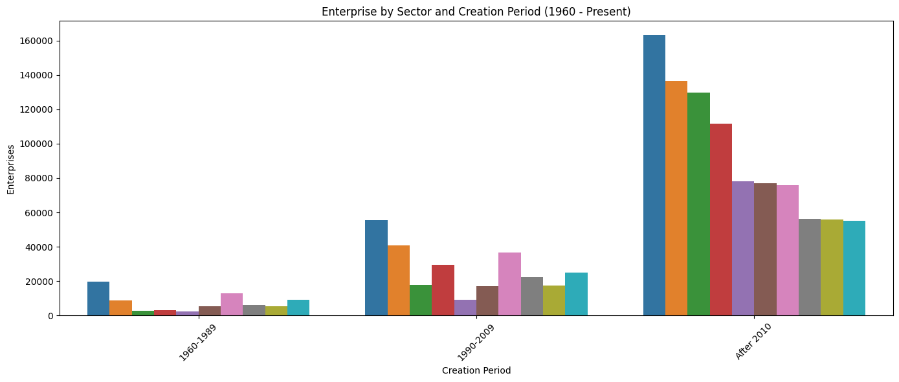
Creation Period by Sector
The plots in this slide are divided to show the extreme differences between the number of enterprises before and after 1960
It is apparent that although Belgian companies can be quite old, is in the last three decades where the creation of companies have exploded. This could be due to economic growth, technology improvement or maybe a change in the regulations

Slide 7
Conclusions
Good and services for the European hub
Business Context Limitations
Belgian commerce is alive and well!. Most Belgians occupied themselves to attend the public and catering to their needs. This includes goods and services, essentials that sustain a country with a prominent international role, where people from different parts of the world live and work.
For projects like this, it would be helpful to consult with a client who has knowledge of the business domain.
Where do we go next?
Infrastructure
Belgium grows and the importance of its construction sector is an indication of infrastructure renewal, modernization and investment.
A more granular approach is necessary: for example to investigate why there is ‘unknowns’ in the juridical form it could be necessary to study the data
The insights in this analysis must be discussed with a business specialist with knowledge in the matter
Growth
The last two decades have been a period of growth for Belgium and its economic development.

Slide 8

Thank you
Link to the Github repository:
Includes :
SQL queries used to extract the data presented
Jupyter notebook for data analysis
Data used in the investigation in csv format

